Slide 1
Data Analytics and Visualization for Digital Forensics
Module 3, Day 2
Dr.ir. Hans Henseler,
University of Applied Sciences Leiden (NL)
Master of Advanced Studies in Digital Forensics & Cyber Investigation
Bern University of Applied Sciences

Slide 2
Module 3: Data Analytics and Visualization
This module teaches the use of data analytics and visualization for digital forensics. Topics covered include:
Log analysis and correlation
Event reconstruction using timelines
Using Plaso to create super-timelines
Working with Big Data repositories
Correlation and relationship analysis
Statistical analysis
Advanced search techniques

Slide 3
Day 2
Day 2 | Plaso and Elasticsearch
08:30 | Part 3: Super-timelines with Plaso
 | Setting up Plaso on your machine
10:30 | Exercise 3: Run Plaso on logfiles and analyse the outcome
12:00 | Lunch
13:00 | Part 4: OpenSearch (OS) and practical use in digital forensics
15:00 | Exercise 4: Index data in OS and analyse with a jupyter notebook
16:20 | End of the day review

Slide 4
Day 2: Learning Goals
Understand and able to use Plaso tools:
Overview of supported sources and formats
Log2timeline, psort and pinfo
Visualisation of Plaso output
Working with Plaso output in Colab
Understand and able to use Opensearch:
Install Opensearch in Colab
Using the Opensearch python API
Filtering and aggregating results with OpenSearch
Learn about practical use of OpenSearch in digital forensics

Slide 5
Part 3: : Super-timelines with Plaso

Slide 6
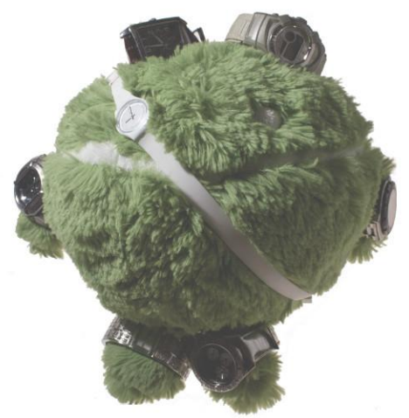
Plaso
Written by: Kristinn Gudjonsson
Plaso (Plaso Langar Að Safna Öllu) is a Python-based backend engine for the tool log2timeline.
Original log2timeline written in Perl and support is limited.
New log2timeline written entirely in Python,
Creates a Super Timeline! Meaning an annotated timeline.
Filters, tagging, file parsers and more!
Comes with some useful plugins
Android_app_usage
Chrome_cache
Mac_keychain analysis
Source: Plaso

Slide 7
Plaso tools
Plaso was initially created to replace the Perl version of log2timeline
Now focus has shifted from a stand-alone tool to a set of modules:
Image_export.py
Psteal.py
Log2timeline.py
Pinfo.py
Psort.py
Log2timeline.py
Pinfo.py
Psort.py
Input: data
Output: plaso file
File filters
Parse filters
Input: plaso file
Output: information about the plaso file (events, reports, sessions, sources, warnings)
Input: plaso file
Output: csv, xlsx and others
Filtering and formatting
Notes:
image_export is a command line tool to export file content from a storage media image or device based on various filter criteria, such as extension names, filter paths, file format signature identifiers, file creation date and time ranges, etc.
log2timeline is a command line tool to extract events from individual files, recursing a directory (e.g. mount point) or storage media image or device. log2timeline creates a Plaso storage file which can be analyzed with the pinfo and psort tools.
The Plaso storage file contains the extracted events and various metadata about the collection process alongside information collected from the source data. It may also contain information about tags applied to events and reports from analysis plugins.
pinfo is a command line tool to provide information about the contents of a Plaso storage file.
psort is a command line tool to post-process Plaso storage files. It allows you to filter, sort and run automatic analysis on the contents of Plaso storage files.
psteal is a command line tool that combines the functionality of log2timeline and psort.

Slide 8
Create a timeline using Psteal.py
The quickest way to generate a timeline with Plaso is using the “psteal” frontend. For example: $ psteal.py --source myimage.raw -o dynamic -w output.csv
This will produce a CSV file containing all the events from an image, with some sensible defaults.
Alternatively, you can use log2timeline.py and psort.py:
$ log2timeline.py --storage-file timeline.plaso image.raw
$ psort.py -o dynamic -w registrar.csv timeline.plaso

Slide 9
Export files using Image_export.py
image_export.py is a command line tool to export file content from a storage media image
Based on filter criteria, such as
extension names, filter paths, file format signature identifiers, file creation date and time ranges, etc.
$ image_export.py --names Security.evtx gdrive/MyDrive/Images/MUS-CTF-19-DESKTOP-001.E01
$ image_export.py -x "doc,docx,xls,xlsx,ppt,pptx" --data \Windows\System32\winevt\Logs gdrive/MyDrive/Images/MUS-CTF-19-DESKTOP-001.E01

Slide 10
Log2timeline.py
Log2timeline.py
Pinfo.py
Psort.py
Input: data
Output: plaso file
File filters
Parse filters
Input: plaso file
Output: information about the plaso file (events, reports, sessions, sources, warnings)
Input: plaso file
Output: csv, xlsx and others
Filtering and formatting
Step 1

Slide 11
Log2timeline.py filtering
Log2timline.py processes source files into the Plaso database
Supports many image formats - Raw, VHD, E01 images, mount points & other Plaso DB files.
Filtering Options available
File Filters
Filter by Parser
Filter by YARA rules
Most basic command format:
log2timeline.py OUTPUT INPUT
For example: log2timeline.py demo.E01 demo.plaso
Also see: https://github.com/mark-hallman/plaso_filters

Slide 12
Log2timeline.py: collection file filters
Filter Files are a list of files to collect
Triage Approach: Collect / Process only what you want
Saves time during collection and analysis
Relevant to image_export and log2timeline
Use the same file / file format
Some items in Filter File may only be relevant for image_export
No plugins to process some files that still; should be collected
Example: pagefile.sys, hiberfile.sys, etc.

Slide 13
Log2timeline.py: filter file format
One entry per line
Each line defines a single location to collect/process
Format is:
FIELD 1 | SEPARATOR | FIELD 2 | SEPARATOR | FIELD 3 | ...
Separator = slash “/”
A field can be one of the following three options:
A string representing the exact directory name, case insensitive.
A regular expression denoting the name of the directory or file.
A name of an attribute collected during the preprocessing stage, denoted by a curly bracket {attribute_name}.
Attribute Name Example: {sysregistry}/.+evt

Slide 14
Log2timeline.py: Filter example
###############
# Recycle Bin and Recycler
###############
/[$]Recycle.Bin
/[$]Recycle.Bin/.+
/[$]Recycle.Bin/.+/.+
/[$]Recycle.Bin/.+/.+/.+
/[$]Recycle.Bin/.+/.+/.+/.+
/RECYCLER
/RECYCLER/.+
/RECYCLER/.+/.+
/RECYCLER/.+/.+/.+
/RECYCLER/.+/.+/.+/.+
###############
# Windows Event Logs
###############
/Windows/System32/winevt/Logs/.+[.]evtx
/Windows/System32/config/.+[.]evt
https://github.com/mark-hallman/plaso_filters/blob/master/filter_windows.txt

Slide 15
Log2timeline.py: parsers
Available on front & back end
Limit processing to specific types of artifacts
Parser Catagories
Parsers: Processes individual artifacts
(amcache, lnk, mft, plist, prefetch …)
Parser Plugins: Processes artifact categories
(apple_id, bag_mru, cron, google_drive …)
Parser Presets: Sets of Parser Presets, Parsers Plugins & Parsers
(winreg, win7, macosx …)
Easy to create your own. Covered later in presentation.
Help and list of all parsers
Log2timeline.py --info
log2timeline.py --parsers list

Slide 16
Log2timeline.py: parsers
--parsers PARSER_FILTER_EXPRESSION
Define which presets, parsers and/or plugins to use,
or show possible values. The expression is a comma
separated string where each element is a preset,
parser or plugin name. Each element can be prepended
with an exclamation mark to exclude the item. Matching
is case insensitive. Examples: "linux,!bash_history"
enables the linux preset, without the bash_history
parser. "sqlite,!sqlite/chrome_history" enables all
sqlite plugins except for chrome_history".
"win7,syslog" enables the win7 preset, as well as the
syslog parser. Use "--parsers list" or "--info" to
list available presets, parsers and plugins.

Slide 17
Log2timeline.py: parser presets
Try “log2timeline.py --parsers list” and you get the complete list with parsers, parser plugins and parser presets (presets shown below):
******************************** Parser Presets *************
Name : Description
--------------------------------------------------------------------------
android : android_app_usage, chrome_cache, filestat, sqlite/android_calls,
sqlite/android_sms, sqlite/android_webview,
sqlite/android_webviewcache, sqlite/chrome_8_history,
sqlite/chrome_17_cookies, sqlite/chrome_27_history,
sqlite/chrome_66_cookies, sqlite/skype
linux : apt_history, bash_history, bencode, czip/oxml, dockerjson, dpkg,
filestat, gdrive_synclog, googlelog, olecf, pls_recall,
popularity_contest, selinux, sqlite/google_drive, sqlite/skype,
sqlite/zeitgeist, syslog, systemd_journal, utmp, vsftpd, webhist,
xchatlog, xchatscrollback, zsh_extended_history
macos : asl_log, bash_history, bencode, bsm_log, cups_ipp, czip/oxml,
filestat, fseventsd, gdrive_synclog, mac_appfirewall_log,
mac_keychain, mac_securityd, macwifi, olecf, plist,
spotlight_storedb, sqlite/appusage, sqlite/google_drive,
sqlite/imessage, sqlite/ls_quarantine,
sqlite/mac_document_versions, sqlite/mac_notes,
sqlite/mackeeper_cache, sqlite/mac_knowledgec, sqlite/skype,
syslog, utmpx, webhist, zsh_extended_history
webhist : binary_cookies, chrome_cache, chrome_preferences,
esedb/msie_webcache, firefox_cache, java_idx, msiecf,
opera_global, opera_typed_history, plist/safari_history,
sqlite/chrome_8_history, sqlite/chrome_17_cookies,
sqlite/chrome_27_history, sqlite/chrome_66_cookies,
sqlite/chrome_autofill, sqlite/chrome_extension_activity,
sqlite/firefox_cookies, sqlite/firefox_downloads,
sqlite/firefox_history, sqlite/safari_historydb
win7 : custom_destinations, esedb/file_history,
olecf/olecf_automatic_destinations, recycle_bin, winevtx, win_gen
win7_slow : esedb, mft, win7
win_gen : bencode, czip/oxml, filestat, gdrive_synclog, lnk,
mcafee_protection, olecf, pe, prefetch, setupapi, sccm,
skydrive_log, skydrive_log_old, sqlite/google_drive, sqlite/skype,
symantec_scanlog, usnjrnl, webhist, winfirewall, winjob, winreg
winxp : recycle_bin_info2, rplog, win_gen, winevt
winxp_slow : esedb, mft, winxp

Slide 18
Log2timeline.py: YARA rules
YARA rules are used to classify and identify malware samples by creating descriptions of malware families based on textual or binary patterns.
YARA is a tool designed to help malware researchers identify and classify malware samples. It’s been called the pattern-matching Swiss Army knife for security researchers (and everyone else).
We have enough on our hands with filters so we won’t be covering YARA rules in Plaso Log2timeline.py in this course.
Want to know more? Check: https://yara.readthedocs.io/en/v3.6.3/index.html

Slide 19
pinfo.py
Log2timeline.py
Pinfo.py
Psort.py
Input: data
Output: plaso file
File filters
Parse filters
Input: plaso file
Output: information about the plaso file (events, reports, sessions, sources, warnings)
Input: plaso file
Output: csv, xlsx and others
Filtering and formatting
Step 2

Slide 20
The plaso storage file
The Plaso storage file contains information about:
When and how the tool was run
Information gathered during the pre-processing stage
Metadata about each storage container or store
What parsers were used during the extraction phase, parameters used
How many extracted events are in the storage file, and count of each parser
If there are tagged events, what tag file was used, what tags have been applied and count for each one
If analysis plugins have been run, an overview of which have been run and the content of the report
You can use pinfo.py tool extract information about the contents of a Plaso storage file: $ pinfo.py timeline.plaso

Slide 21
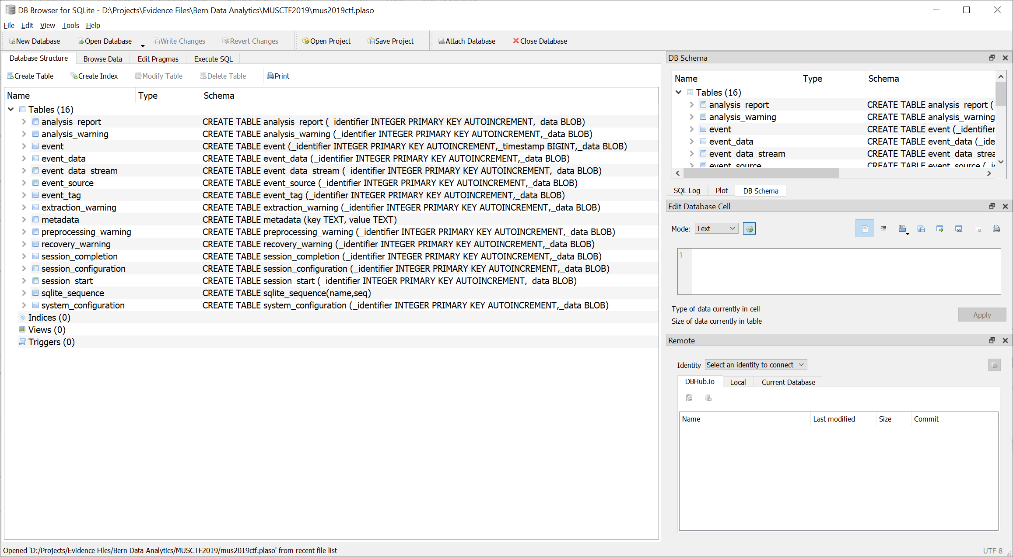
Plaso storage file is a SQLite db

Slide 22
Pinfo.py
************************** Plaso Storage Information ***************************
Filename : winsecurity.plaso
Format version : 20210514
Storage type : session
Serialization format : json
--------------------------------------------------------------------------------
*********************************** Sessions ***********************************
25bd56e2-b47c-4be9-9751-6d8840737042 : 2021-08-17T19:24:08.038520Z
--------------------------------------------------------------------------------
**************** Session: 25bd56e2-b47c-4be9-9751-6d8840737042 *****************
Start time : 2021-08-17T19:24:08.038520Z
Completion time : 2021-08-17T19:24:46.162369Z
Product name : plaso
Product version : 20210606
Command line arguments : /usr/bin/log2timeline.py -f
filter_windows_security_evtx.txt --storage_file
winsecurity.plaso
/content/gdrive/MyDrive/Images/MUS-CTF-19-DESKTOP-001.E01
--status_view none --parsers winevtx
Parser filter expression : winevtx
Enabled parser and plugins : winevtx
Preferred encoding : UTF-8
Debug mode : False
Artifact filters : N/A
Filter file : filter_windows_security_evtx.txt
--------------------------------------------------------------------------------
******************************** Event sources *********************************
0 : type: OS, location:
/content/gdrive/MyDrive/Images/MUS-CTF-19-DESKTOP-001.E01
: type: EWF
: type: TSK_PARTITION, location: /p1, part index: 2, start offset: 0x22600000
: type: NTFS, location: \Windows\System32\winevt\Logs\Security.evtx, MFT
attribute: 2, MFT entry: 83669
--------------------------------------------------------------------------------
************************* Events generated per parser **************************
Parser (plugin) name : Number of events
--------------------------------------------------------------------------------
winevtx : 29238
Total : 29238
--------------------------------------------------------------------------------
No events labels stored.
No analysis reports stored.
Provides info on the Plaso database:
Command line used for log2timeline
Event counts, Parser Counts
Tagging & other Analysis plugins runs
Can be helpful to tune you log2timeline command options.

Slide 23
psort.py
Log2timeline.py
Pinfo.py
Psort.py
Input: data
Output: plaso file
File filters
Parse filters
Input: plaso file
Output: information about the plaso file (events, reports, sessions, sources, warnings)
Input: plaso file
Output: csv, xlsx and others
Filtering and formatting
Step 3

Slide 24
Psort.py filtering
Backend Work horse
Deduping
Filtering – This is key to using the tool effectively
Analysis – Can be used to update the database and then filter on the updates
Most basic command format:
Psort.py –w OUTPUT INPUT
Osort.py –w win10_security_evtx.csv win10_security_evtx.plaso

Slide 25
Psort.py: usage
usage: psort.py [-h] [--troubles] [-V] [--analysis PLUGIN_LIST]
[--process_memory_limit SIZE]
[--temporary_directory DIRECTORY] [--worker_memory_limit SIZE]
[--worker_timeout MINUTES] [--logfile FILENAME] [-d] [-q] [-u]
[--status_view TYPE] [--slice DATE_TIME]
[--slice_size SLICE_SIZE] [--slicer] [--data PATH] [-a]
[--language LANGUAGE] [--dynamic_time]
[--output_time_zone TIME_ZONE] [-o FORMAT] [-w OUTPUT_FILE]
[--fields FIELDS] [--additional_fields ADDITIONAL_FIELDS]
[--profilers PROFILERS_LIST] [--profiling_directory DIRECTORY]
[--profiling_sample_rate SAMPLE_RATE]
[PATH] [FILTER]
We demonstrate some uses of Psort.py in Colab

Slide 26
Psort.py: output file formats
******************************** Output Modules ********************************
Name : Description
--------------------------------------------------------------------------------
dynamic : Dynamic selection of fields for a separated value output format.
elastic : Saves the events into an Elasticsearch database.
elastic_ts : Saves the events into an Elasticsearch database for use with
Timesketch.
json : Saves the events into a JSON format.
json_line : Saves the events into a JSON line format.
kml : Saves events with geography data into a KML format.
l2tcsv : CSV format used by legacy log2timeline, with 17 fixed fields.
l2ttln : Extended TLN 7 field | delimited output.
null : Output module that does not output anything.
rawpy : native (or "raw") Python output.
tln : TLN 5 field | delimited output.
xlsx : Excel Spreadsheet (XLSX) output
--------------------------------------------------------------------------------

Slide 27
L2TCSV fields
# | Field | Description
1 | date | Date of the event, in the format of MM/DD/YYYY
2 | time | Time of day, expressed in a 24h format, HH:MM:SS
3 | timezone | Time zone that was used to call the tool with.
4 | macb | MACB meaning of the fields, mostly for compatibility with the mactime format.
5 | source | Short name for the source. All web browser history is, for instance, WEBHIST, registry entries are REG, simple log files are LOG, and so on.
6 | sourcetype | More comprehensive description of the source, “Internet Explorer” instead of WEBHIST, etc.
7 | type | Type of the timestamp itself, such as “Last Accessed,” “Last Written,” or “Last modified,” and so on.
8 | user | Username
9 | host | Hostname
10 | short | Short description of the entry, usually contains less text than the full description field.
11 | desc | Description field, this is where most of the information is stored, the actual parsed description of the entry.
12 | version | Version number of the timestamp object.
13 | filename | Filename with the full path of the filename that contained the entry.
14 | inode | Inode number of the file being parsed.
15 | notes | Some input modules insert additional information in the form of a note.
16 | format | Name of the input module that was used to parse the file.
17 | extra | Additional information parsed is joined together and put here.

Slide 28
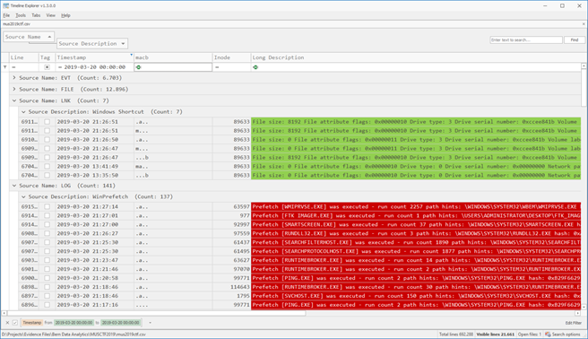
TimelineExplorer
By Eric Zimmerman
https://ericzimmerman.github.io/#!index.md
Useful for inspecting csv output from psort.py!

Slide 29
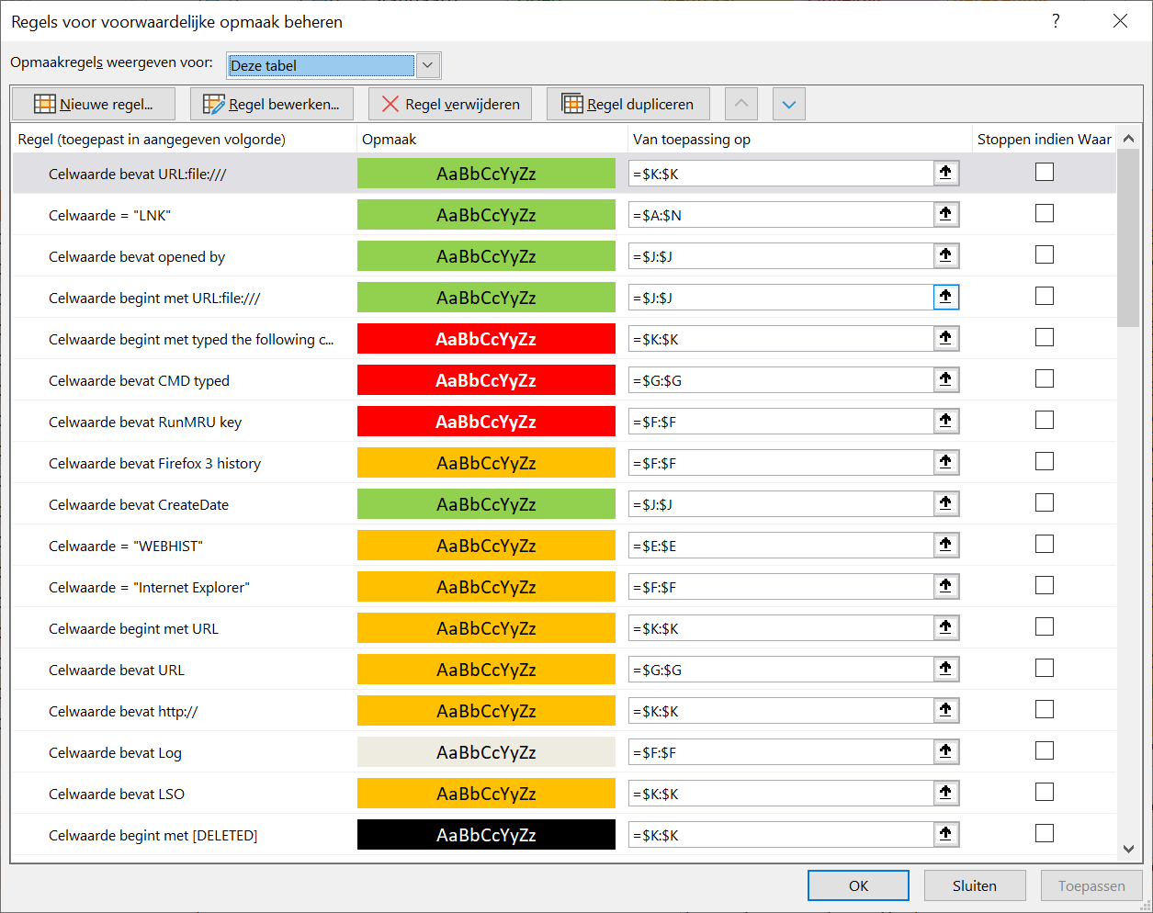
SANS Colorized Super Timeline
Similar to TimelineExplorer but in Excel
Excel Template file contains conditional formatting rules:
Light green: file opening
Yellow: web history
Black: deleted data
Red: execution
Blue: device or USB Usage
Green: folder opening
Grey: log file
https://www.sans.org/blog/digital-forensic-sifting-colorized-super-timeline-template-for-log2timeline-output-files/

Slide 30
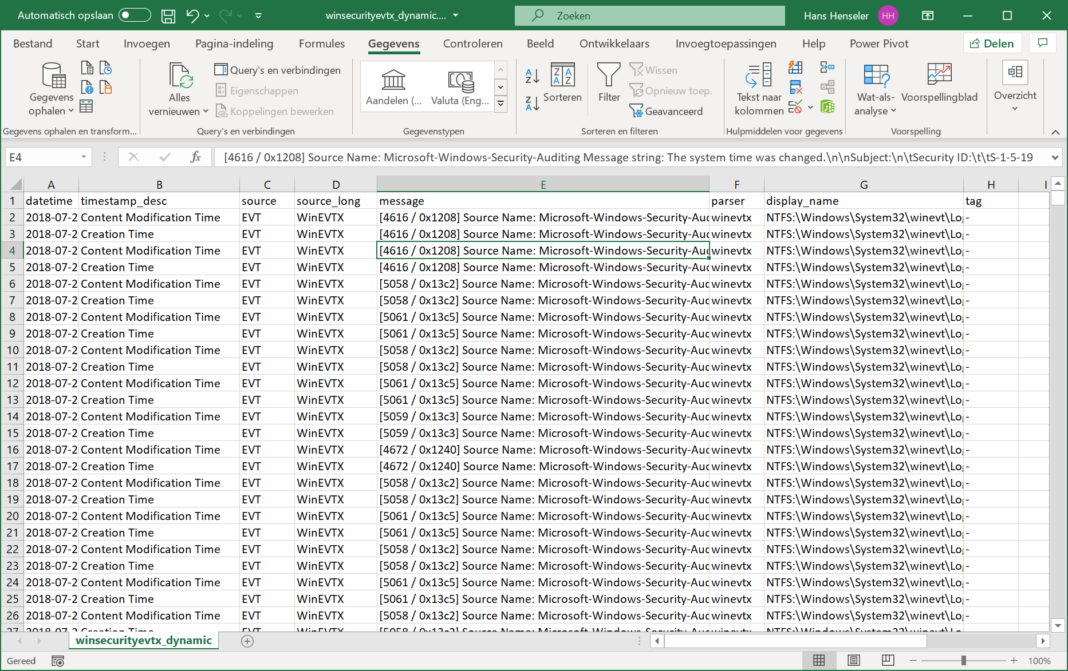
Psort.py: dynamic output format sample
Default fields:
datetime
display_name
message
source
sourcetype
tag
timestamp_desc
parser

Slide 31
Psort.py: dynamic output module fields
There is no complete overview of all additional fields in the dynamic format
The name of the fields typically map 1-to-1 to the names of attributes of the event data.
However, there are “special” fields that are composed at runtime.
Default | Name | Description
 | date | The date of the event formatted as "YYYY-MM-DD" or "0000-00-00" on error
yes | datetime | The date and time of the event in ISO 8601 format in microseconds or "0000-00-00T00:00:00.000000+00:00" on error
 | description | The event message string as defined by the message formatter
 | description_short | The short event message string as defined by the message formatter
yes | display_name | Human readable representation of the path specification
 | filename | The "filename" attribute if present in the event data otherwise derived from the path specification
 | host | The hostname derived by pre-processing
 | hostname | The hostname derived by pre-processing
 | inode | The "inode" attribute if present in the event data otherwise derived from the file system identifier (such as inode MFT entry) in the path specification
 | macb | MACB (Modification, Access, Change, Birth) group representation
yes | message | The event message string as defined by the message formatter
 | message_short | The short event message string as defined by the message formatter
yes | source | The short event source as defined by the message formatter
yes | sourcetype | The event source as defined by the message formatter
 | source_long | The event source as defined by the message formatter
yes | tag | The labels defined by event tags
 | time | The time of the event in seconds formatted as "HH:MM:SS" or "--:--:--" on error
yes | timestamp_desc | Indication of what the event time represents such as Creation Time or Program Execution Duration
 | timezone | Time zone indicator
 | type | Indication of what the event time represents such as Creation Time or Program Execution Duration
 | user | The username derived by pre-processing
 | username | The username derived by pre-processing
 | zone | Time zone indicator
yes | parser | Which parser was used
 | data_type | Event data type
 | short_source | short source identifier that corresponds with the l2tcsv and tln source field
https://plaso.readthedocs.io/en/latest/sources/user/Output-and-formatting.html

Slide 32
Psort.py: Filtering on data_type
Can provide more granularity that any other single field
In some cases, sourcetype, parser and data_type can provide the same results
For some types context sensitive fields can be used for additional filtering:
windows:lnk:link
windows:registry:sam_users
windows:prefetch:execution
windows:evtx:record
These are just a few examples, there are many more. These context sensitive fields were found by Mark Hallman reviewing the Plaso formatters on the Plaso GitHub page.

Slide 33
Psort.py: filtering on LNK files
Data Type = ‘windows:lnk:link’
Context sensitive fields:
Field | Description
birth_droid_file_identifier | distributed link tracking birth droid file identifier.
birth_droid_volume_identifier | distributed link tracking birth droid volume identifier.
command_line_arguments command | line arguments.
description | description of the linked item.
drive_serial_number | drive serial number where the linked itemÂ resides.
drive_type | drive type where the linked item resided.
droid_file_identifier | distributed link tracking droid fileÂ identifier.
droid_volume_identifier | distributed link tracking droid volume identifier.
env_var_location | evironment variables loction.
file_attribute_flags | file attribute flags of the linked item.
file_size | size of the linked item.
icon_location | icon location.
link_target | shell item list of the link target.
local_path | local path of the linked item.
network_path | local path of the linked item.
relative_path | relative path.
volume_label | volume label where the linked item resided.
working_directory | working directory.

Slide 34
Psort.py: filtering on SAM registry
data_type = ‘windows:registry:sam_users’
Context sentive fields:
Field | Type | Description
account_rid | (int) | account relative identifier (RID).
comments | (str) | comments
fullname | (str) | full name
key_path | (str) | Windows Registry key path
login_count | (int) | login count
username | (str) | username (str)

Slide 35
Psort.py: filtering on Prefetch files
data_type = ‘windows:prefetch:execution’
Context sentive fields:
Field | Type | Description
executable | (str) | executable filename
format_version | (int) | format version
mapped_files | (list[str]) | mapped filenames
number_of_volumes | (int) | number of volumes
path | (str) | path to the executable
prefetch_hash | (int) | prefetch hash
mapped_files | (list[str]) | mapped filenames
volume_device_paths | (list[str]) | volume device paths
volume_serial_numbers | (list[int]) | volume serial numbers

Slide 36
Psort.py: filter example
Sample of Evidence of Execution logic used by Timeline Explorer. Developed by Eric Zimmerman.
This logic can be implemented as a psort.py filter.
psort -z "UTC" -o l2tcsv -w execution_test.csv file_filter.plaso
"message contains 'Prefetch {' or
message contains 'AppCompatCache' or
message contains 'typed the following cmd' or
message contains 'CMD typed' or
message contains 'Last run' or
message contains 'RunMRU' or
message contains 'MUICache' or
message contains 'UserAssist key' or
message contains 'Time of Launch' or
message contains 'Prefetch' or
message contains 'SHIMCACHE' or
message contains 'Scheduled' or
message contains '.pf' or
message contains 'was run' or
message contains 'UEME_' or message contains '[PROCESS]'"

Slide 37
Psort.py: time filtering on date range
Filter on the datetime field
$ psort.py -o l2tcsv -w datetime.csv
win7.plaso "datetime > '2019-03-17 00:00:00' AND datetime <'2019-03-20 00:00:00‘

Slide 38
Psort.py: time filtering using slice
Provides context around an date/time
Create a time slice around a certain date
Display all events that happened X minutes before and after the defined date
--slice_size defines the size of the slice
Defaults to 5 minutes.
$ psort.py -o l2tcsv --slice '2019-03-14 22:12:00’
-w slice.csv win7.plaso
"data_type is 'windows:lnk:link’ AND drive_type == 3"

Slide 39
Psort.py: time filtering using slicer
Creates a Time Slice Around every Filter match
Will save all X events before and after a filter match
X is set with the --slice option
Defaults to 5 events.
$psort.py -o l2tcsv --slicer -slice_size 10
-w slicer.csv win7.plaso
"data_type is 'windows:lnk:link’ AND drive_type == 3"

Slide 40
Psort.py: more help on filtering
Additional sources on psort.py and filtering:
https://plaso.readthedocs.io/en/latest/sources/user/Using-psort.html
https://plaso.readthedocs.io/en/latest/sources/user/Event-filters.html
http://blog.kiddaland.net/2012/12/log2timeline-filtering-101.html
Try asking a large language model
Make sure that it reads the pages above as part of your request or before you ask (e.g. ask it for a summary).

Slide 41
Examples part 3: Run Plaso on logfiles and analyse the outcome
9:30-10:00

Slide 42
10:00-10:15

Slide 43
Exercise 3: Run Plaso on logfiles and analyse the outcome

Slide 44
Exercise timings
20 minutes per exercise (app) and 5 minutes recap
10:40 recap exercise 1
11:05 recap exercise 2
11:30 recap exercise 3
11:55 recap exercise 4

Slide 45
12:00-13:00

Slide 46
Part 4: Opensearch (OS) and practical use in digital forensics

Slide 47
NoSQL + open/Elastic sEaRch

Slide 48
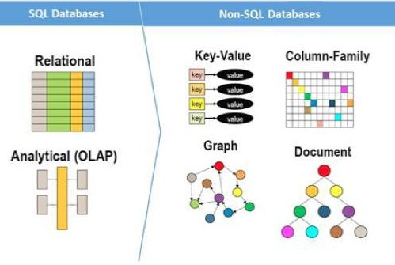
Big Data Variety: NoSQL
Store data as it is (easier for ETL)
Better support for unstructured data (e.g. text)
Variable database format (no fixed schema)
No SQL language but API access
Scale horizontally (adding more computing nodes)

Slide 49










NoSQL types
Key-value
Graph database
Document-oriented
Column family
Notes:
Huge quantity of data => Distributed systems => expensive joins =>
New fields, new demands (graphs) =>
Different data strucutres:
Simplier or more specific

Slide 50
Example: MongoDb
A MongoDB instance may have zero or more databases
A database may have zero or more ‘collections’.
A collection may have zero or more ‘documents’.
A document may have one or more ‘fields’.
MongoDB ‘Indexes’ function much like their RDBMS counterparts.
https://www.mongodb.com/what-is-mongodb

Slide 51

MongoDB vs. RDBMS
Collection vs. table
Document vs. row
Field vs. column
Collection isn't strict about what goes in it (it's schema-less)

Slide 52


Elasticsearch
“flexible and powerful open source, distributed real-time search and analytics engine for the cloud” (http://www.elasticsearch.org/)
Features: real time data, real time analytics, distributed, high availability, multi-tenancy, full text search, document oriented, conflict management, schema free, restful api, per-operation persistence, Apache 2 open source license, build on top of Apache Lucene.

Slide 53
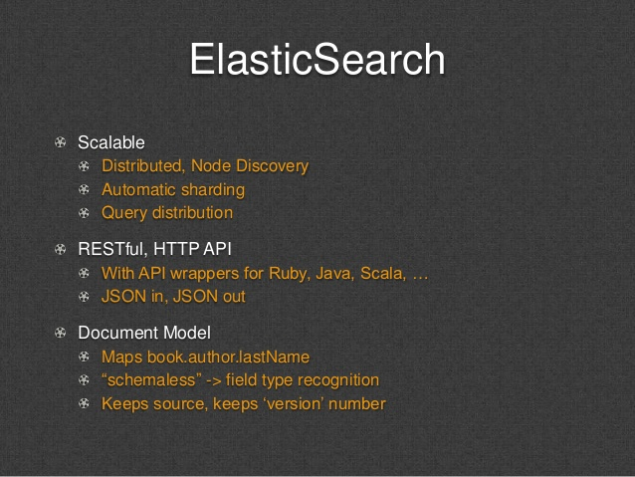
Elasticsearch
Since 2010.
Version: 0.90.5
Sample list of customers
ProQuest Udini
StumbleUpon
Mozilla
Quora
Foursquare
Etsy
SoundCloud
and GitHub.

Slide 54
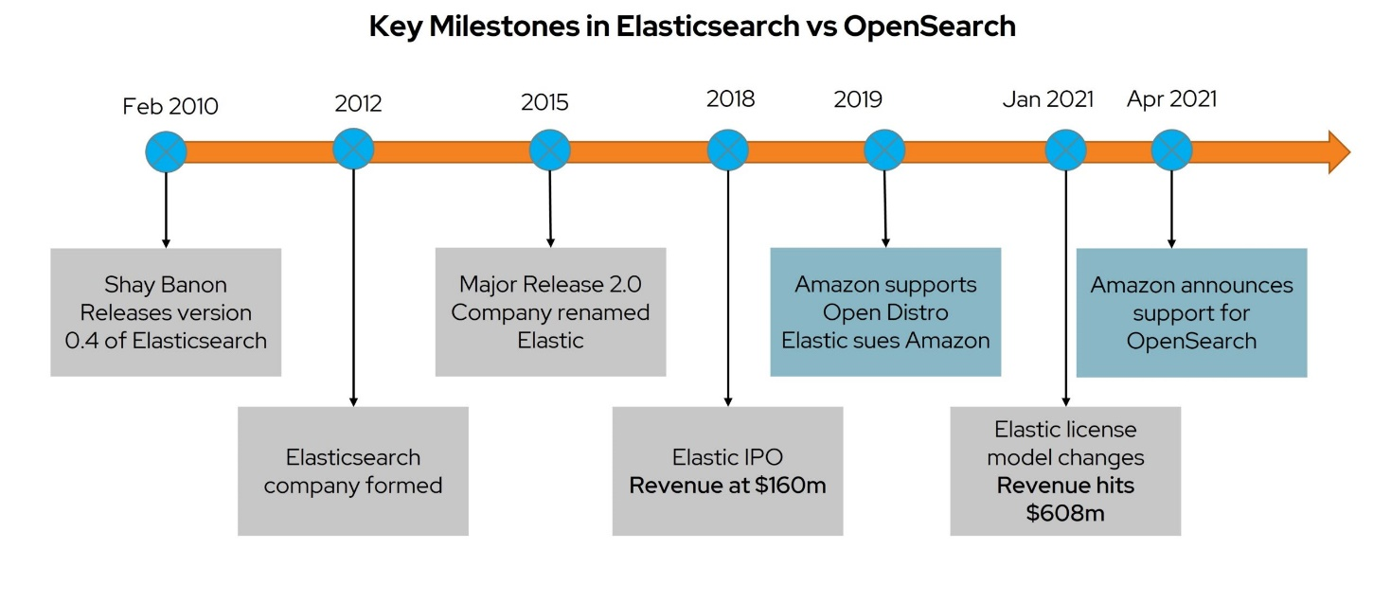
Opensearch vs Elasticsearch
In early 2021, on the heels of a major licensing change by Elastic, Amazon announced the OpenSearch project.
OpenSearch is a fork of the Elasticsearch and Kibana code base which will remain under the Apache 2.0 license.
Read more:
https://pureinsights.com/blog/2021/elasticsearch-vs-opensearch-user-point-of-view-part-1-of-3/

Slide 55
Data In : WLCG Example
Typical row: { "src_site": "PIC", "src_host": "srmcms.pic.es", "dst_site": "GRIF", "dst_host": "polgrid4.in2p3.fr", "vo": "cms", "server": "https://fts.pic.es:8443/glite-data-transfer-fts/services/FileTransfer", "channel": "PIC-HTCMSDSTGROUP", "technology": "fts", "is_remote_access": 1, "is_transfer": 1, "period_end_time": "2013-07-01T00:10:00", "files_xs": 1, "errors_xs": 0, "bytes_xs": 2692475011, "streams": 10, "transfer_time": 141, "srm_preparation_time": 7, "srm_finalization_time": 13 }
Worldwide LHC Computing Grid
global collaboration of around 170 computing centres in more than 40 countries, linking up national and international grid infrastructures.
Mission:
provide global computing resources to store, distribute and analyse the ~50-70 Petabytes of data expected every year of operations from the Large Hadron Collider (LHC) at CERN on the Franco-Swiss border.
1 month (July 2013) of statistics:
12.868.127 rows

Slide 56
Data In : Upload
Define index { "mappings" : { "tfr_metric_ng": { "_timestamp" : { "enabled" : "true", "store":"yes" }, "_ttl" : { "enabled": "true"}, "properties" : { "src_site" : {"type" : "string", "index" : "not_analyzed" }, "dst_site" : {"type" : "string", "index" : "not_analyzed" }, "src_host" : {"type" : "string", "index" : "not_analyzed" }, "dst_host" : {"type" : "string", "index" : "not_analyzed" }, "vo" : {"type" : "string", "index" : "not_analyzed" }, "server" : {"type" : "string", "index" : "not_analyzed" }, "channel" : {"type" : "string", "index" : "not_analyzed" }, "technology" : {"type" : "string", "index" : "not_analyzed" }, "is_remote_access" : {"type" : "boolean" }, "is_transfer" : {"type" : "boolean" }, "period_end_time" : {"type" : "date"}, "files_xs" : {"type" : "integer"}, "errors_xs" : {"type" : "integer"}, "bytes_xs" : {"type" : "long"}, "streams" : {"type" : "integer"}, "transfer_time" : {"type" : "integer"}, "srm_preparation_time" : {"type" : "integer"}, "srm_finalization_time" : {"type" : "integer"} } } } } curl -XPOST dashb-ai-415:9200/tfr_metric_ng_201307 --data-binary @typedef_ng.txt
Upload data curl -s -XPOST dashb-ai-415:9200/_bulk --data-binary @table_export_ng_201307.txt

Slide 57
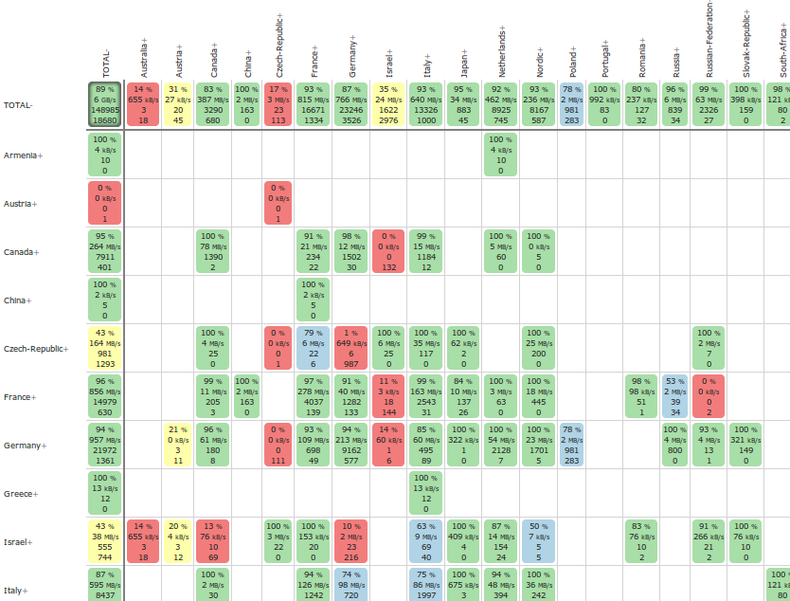

Data Out : Matrix
Matrix statistics
bytes, successes, failures
Intervals
4h
24h
48h
Filtering:
technology = fts
vo = atlas
Grouping
UI = src_country, dst_country
DB = src_site, src_host, dst_site, dst_host, technology

Slide 58
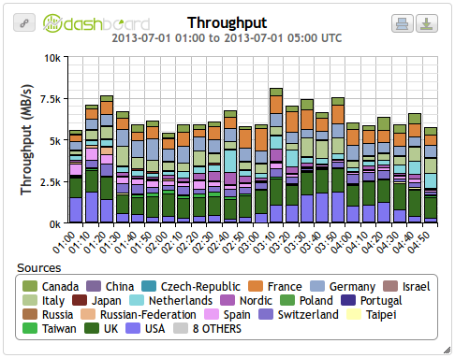
Data Out : Plots
Plot statistics
bytes, successes, failures
Intervals
4h (10 minute bins)
24h (hourly bins)
48h (hourly bins)
Filtering:
technology = fts
vo = atlas
Grouping
UI = src_country
DB = src_site, src_host, technology

Slide 59
Grouping : Elasticsearch Features
“The usual purpose of a full-text search engine is to return a small number of documents matching your query. Facets provide aggregated data based on a search query.” (http://www.elasticsearch.org/guide/reference/api/search/facets/ )
Facets
The statistical facet computes count, total, sum of squares, mean, min, max, var, and std dev on a numeric field.
The terms_stats facet groups statistical data by terms of a single field.
The date_histogram facet groups statistical data by time bins

Slide 60
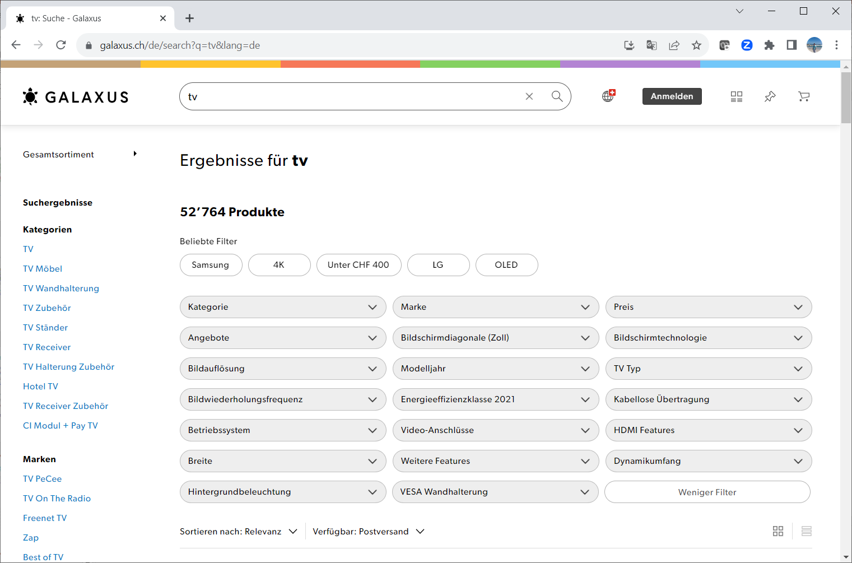
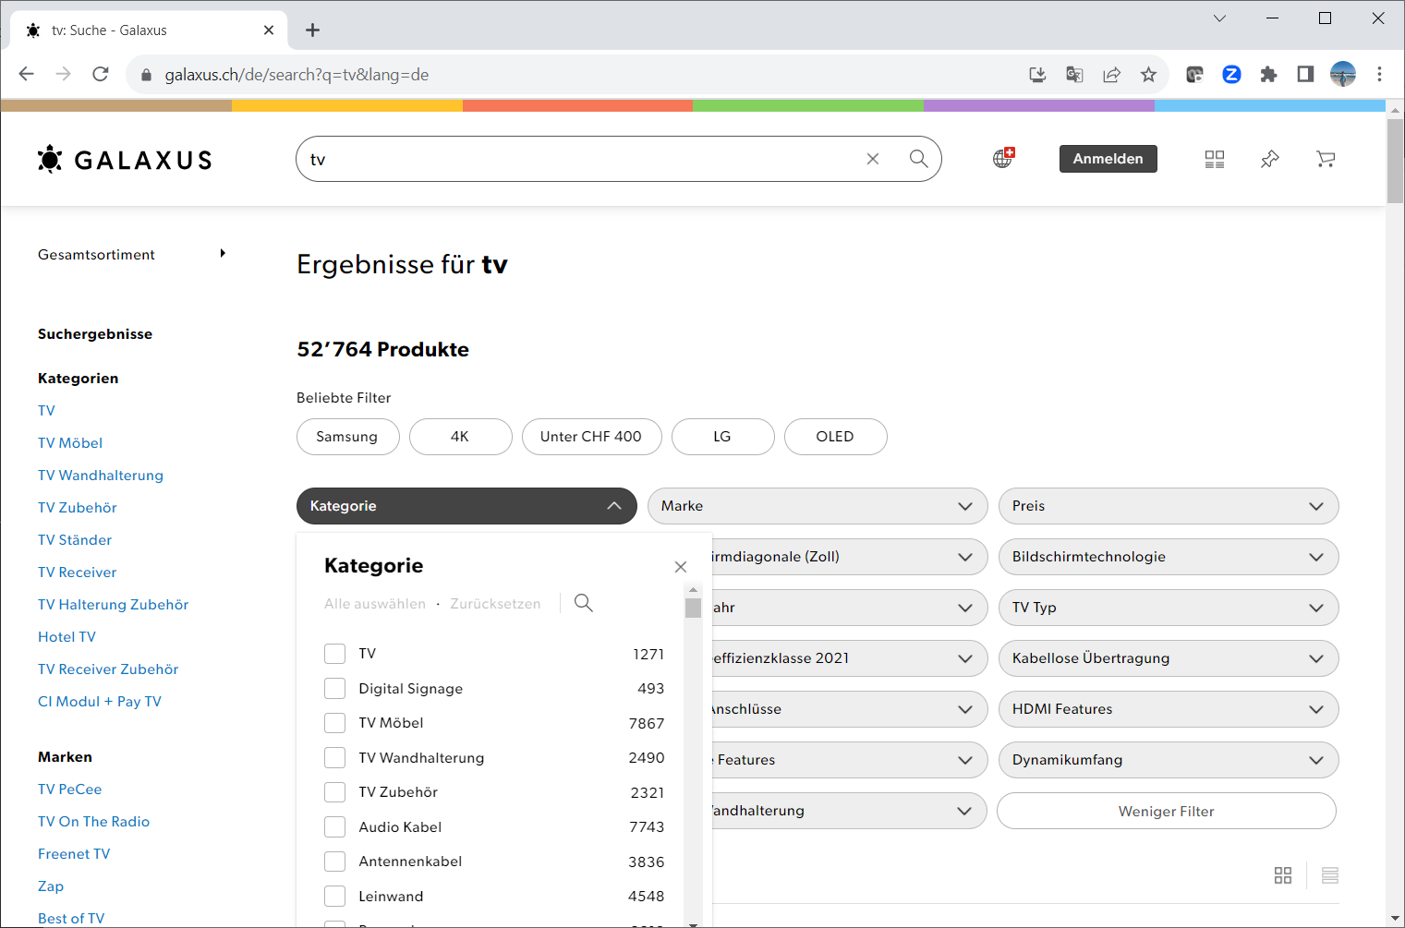
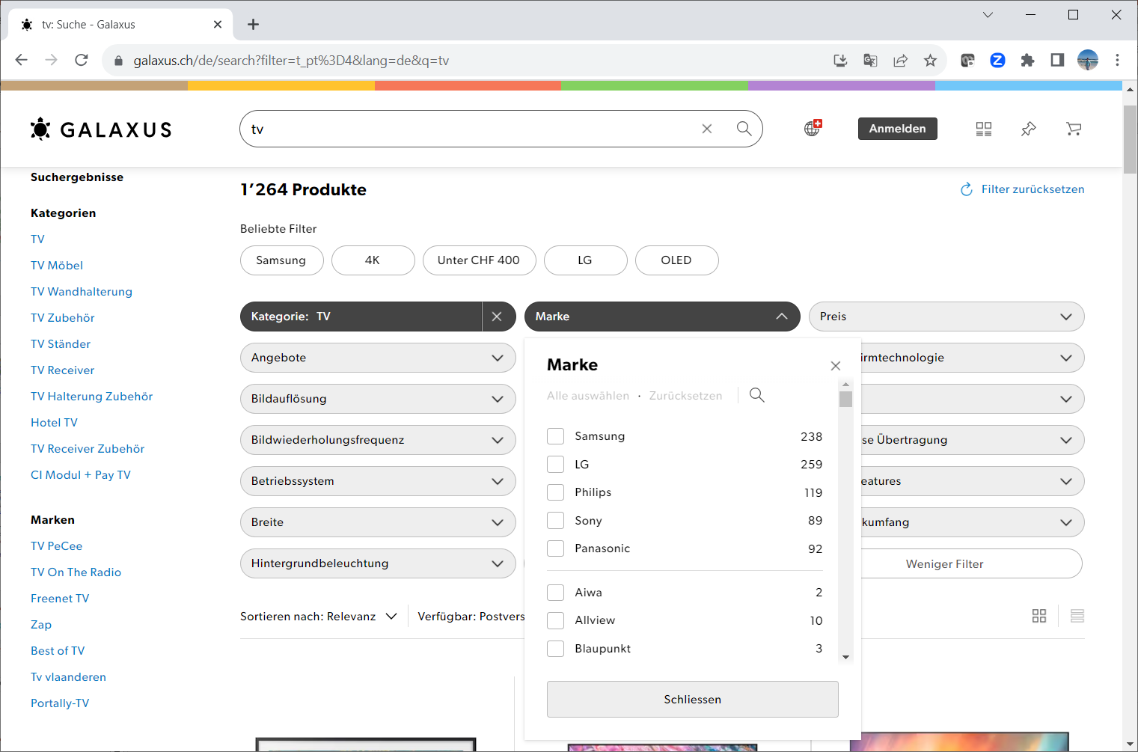
Example of facet search / aggregation

Slide 61
ElasticSearch vs NoSQL
ElasticSearch has better (full-text) search performance
But it is not ACID = a set of properties that guarantee validity of the database even in the event of errors.
So for maintaining the “truth” it is better to use a (No)SQL database and use ElasticSearch for searching
Because ElasticSearch is not ACID, it can cheat and do a lot of caching without having to worry about complicated versioning etc.

Slide 62
(No)Schema
ElasticSearch is schemaless.
ElasticSearch will try to guess field types. It is not always 100% accurate, at least when comparing to the manual creation of the index mappings, but it works quite well.
No fixed data structure
Supports unstructured information, such as, Tweeter feeds, Facebook conversations.

Slide 63
Elasticsearch Index
In ElasticSearch you can have multiple types of documents in a single Index.
This means that you can index documents of different index structure (for example users and their documents) in a single Index.
ElasticSearch is able to distinguish those Types during indexing as well as querying.
In order to achieve the same with Solr you would have to simulate that inside your application or develop a custom search component.

Slide 64
Distributed
ElasticSearch is distributed. No separate project required. Replicas are near real-time with "Push replication”.
ElasticSearch fully supports the near real-time search of Apache Lucene.
Handling multitenancy [Cloud] is not a special configuration, whereas a more advanced setup is necessary with Solr.
ElasticSearch introduces the concept of the Gateway, which makes full backups easier.

Slide 65
Hansken Digital Forensics as a Service platform
Practical example of Elasticsearch used in digital investigations

Slide 66












Digital Forensics (traditional)
1010110
0110101
1001011
0101100
0010110
0111101
1100001
1100101
analyst
1111110
0000101
0111011
1101100
digital
expert
1101110
0100001
1001111
0110110
case
investigator
digital material
data under investigation
Notes:
Traditionele werkwijze digitaal materiaal binnen de opsporing (digi buiten het zaakteam is bottleneck, kent vraag achter de vraag niet)

Slide 67



















Digital Forensics as a Service
1010110
0110101
1001011
0101100
analyst
digital
expert
1111110
0000101
0111011
1101100
digital
expert
1101110
0100001
1001111
0110110
digital material
data under investigation
extraction
engine
trace
database
case
investigator
Notes:
Traditionele werkwijze digitaal materiaal binnen de opsporing (digi buiten het zaakteam is bottleneck, kent vraag achter de vraag niet)

Slide 68
Hansken
One example of such a DFaaS platform is Hansken, a solution that has been built by the Netherlands Forensic Institute.
Today Hansken has been adopted and is being maintained as a closed-source solution by a growing international community of law enforcement and investigating agencies.
See https://hansken.org/ for more information including media, literature, Hansken Community, Vision and Hansken Academy.
Hansken is for Law Enforcement and Intelligence agencies only.
Hansken can be used also by Academia that have a Hansken R&D non-commercial license agreement

Slide 69

Hansken: the open digital forensic platform
Hansken is the open digital forensic platform
Extensible by all users
Parts can be replaced
Investigate (LEA only)
use the platform for crime case investigations
Use the platform for intelligence investigations
efficient mobilization: case investigators, digital experts, analysts, data scientists, advocacy, judges
Innovate
R&D with focus on extending DF knowledge
continuous development of the platform itself
Share
Hansken is a knowledge “hub”
share DF methods and procedures
share DF tools and technology
extended version is available at https://www.hansken.nl/hansken-community/vision

Slide 70
Hansken’s main characteristics
Governmental
developed and maintained by Netherlands Forensic Institute √
Steering committee by Dutch governmental partners √
Transparent
all evidence is traceable (chain of evidence) √
advanced logging of embedded data processors √
Scalable
>1500 cases, >100 concurrent cases √
cases with >1000 seized devices √
cases with >100 terabytes of data √
cases with >100 million traces √
Legal
all handling of traces is auditable (chain of custody) √
support for handling privileged communication √
profound judicial review in Dutch courts √

Slide 71
Digital Forensics as a Service @NFI
internship
XIRAF
R&D
XIRAF
> 500 cases
2005
2006
2010
2012
2015
2016
2018
2019
Hansken
R&D
Hansken
> 1,000 cases
Hansken withstands judicial review
international Hansken community

Slide 72
Hansken technology overview
Keycloak
ID provider
NGINX + JavaScript (Knockout, AngularJS, React) & Python API
GUIs & scripts
Gatekeeper service
authentication & authorization
Keystore
key mgmt
Prefs.
service
user prefs
Monitoring service
A&A service
authori-zations
Lobby service
orchestration & routing
Cassandra
Cassandra
Grafana
Open
LDAP
Project service
admin
Data service
data store
Extraction service
process
Trace service
trace index
Kafka Queues
Cassandra
Hadoop HDFS
CEPH
Cassandra
Hadoop Map-Reduce
forensic
libraries
Elastic-search
JRE in VM (Ubuntu)

Slide 73
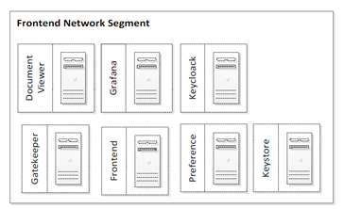
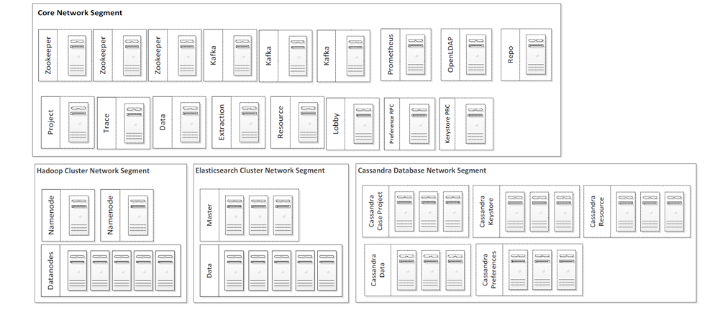
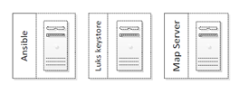
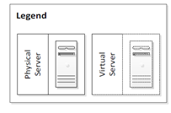
Hansken Infrastructure landscape

Slide 74

Analysis in Hansken
evidence item
Current extraction flow
Every trace is enriched only once
Every trace has a single ‘parent’
Simple & elegant (no silver bullet)
Traces are not combined / linked
Post-analysis done with Python where extra traces can be added
traces

Slide 75
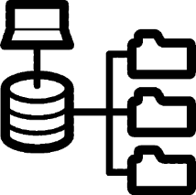
File systems
HFS/HFS+
EXT2/3/4
FAT32
exFAT
XBOX /360
NTFS
ISO9660
ReiserFS
UDF
UFS
BTRFS
XFS
FFSv3 (QNX)
APFS (SleuthKit )

Slide 76
Supported formats / types / things
E-mail
Crypto (volumes, files)
File systems
Archives
Virtual containers
Internet activity
Messaging
Crypto currency
Registry files
OCR
…
Logs
Pictures
Videos
Intercepted data
Executables
Carving
Hash hit(s)
…

Slide 77
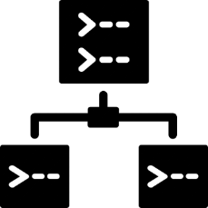
Entities
Mail addresses
URLs
Phone numbers
Credit card numbers
IBANs
IMSI/IMEI
Coin addresses
…
Dutch licence plates
Dutch postal codes
Dutch social security codes

Slide 78



Image recognition
Google Tensorflow-based publicly available pre-trained model
Retrained to detect interesting things
Cash money
Drugs
Weapons
Shipping containers
Chemical supplies
Also OpenCV, OpenFace:
Label prediction
Face detection
Age estimation

Slide 79
Analysis in Hansken
Combining of traces creates lots of possibilities:
List of installed applications / apps
Operating system information (users, activity, platform)
Wifi / network connections
Automated decryption of password containers
Deduplication of traces
Visualisation pre-processing
Clustering of faces / images
PRNU (camera matching)
Multipart archives (Zip is already implemented)
…

Slide 80
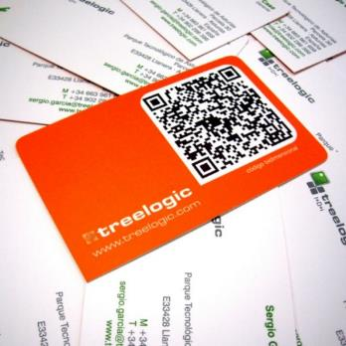
Future/ongoing work in Hansken
Improving scene text recognition
Face recognition (not identification)√
Similarity search
Clustering of similar things (like faces)
Deep speech (speech to text, gender, mood)
Human-readable locations (GPS to street name)
Language translations
Multilingual OCR
Facilitate Hansken plugins:
Extraction modules √
Visualization modules

Slide 81
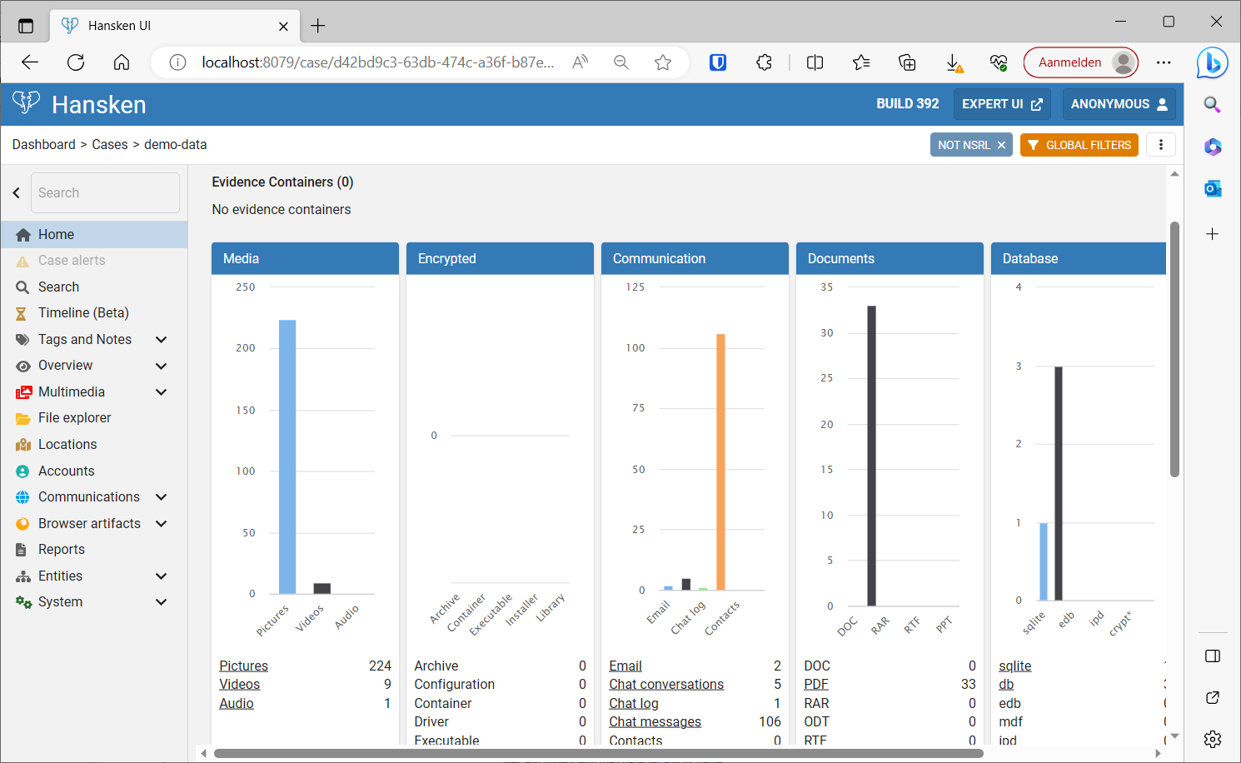
Hansken demo
Short demo of Hansken using the Hansken SDK virtual machine
Different types of UI’s
Hansken Query Language
Trace Model

Slide 82
Exercise 4: Index data in OpenSearch and analyse with a jupyter notebook

Slide 83
Exercise timing
20 minutes per exercise and 5 minutes recap
14:15-14:20 Examples, end with 13 minute export of plaso file to Opensearch in our colab notebook
14:20-14:35 break

Slide 84
14:20-14:35

Slide 85
Exercise timing
20 minutes per exercise and 5 minutes recap
14:35-14:40 Examples continued
15:30 Recap exercise 1 & 2
15:45 Recap exercise 3
16:20 Recap exercise 4

Slide 86
Day 2: What have you learned?
Understand and able to use Plaso tools:
Overview of supported sources and formats
Log2timeline, psort and pinfo
Visualisation of Plaso output
Working with Plaso output in Colab
Understand and able to use Opensearch:
Install Opensearch in Colab
Using the Opensearch python API
Filtering and aggregating results with Opensearch
Learn about practical use of Elasticsearch in digital forensics
Hansken as a practical example

Slide 89
Contact information
Dr.ir. Hans Henseler
henseler.h@hsleiden.nl

